Slide 1
Configuring and Managing Sharepoint Online
Spotkanie poprowadzi: Arkadiusz Strzeżek i Maciej Skibicki
Arkadiusz.Strzezek@promise.pl
tel: 603499057

Slide 2
Agenda
Intro
Omówienie Usługi Sharepoint Online
Sharepoint Administration — przybornik i narzędzia do pracy
Za co odpowiada Administrator Sharepoint
Narzędzia do zarządzania Sharepoint Online
Omówienie Sharepoint Admin Center
Omówienie PowerShell Management
Sharepoint PnP Module
Microsoft Graph
LAB-01
Planowanie i konfigurowanie zbiorów witryn i witryn HUB
Omówienie Architektury Sharepoint Classic
Omówienie Architektury Sharepoint Modern
Omówienie Szablonów i struktur witryn Classic oraz Modern
Omówienie Grupy M365
Zarządzanie oraz planowanie witrynami
Sharepoint HUB Site planowanie struktury intranetu oraz witryn
Uprawnienia witryn
LAB-02
4. Konfigurowanie udostępniania zewnętrznego
Typy mechanizmów udostępniania zewnętrznego
Zarządzanie udostępnianiem zawartości EntraID/Sharepoint Online
LAB-03
5. Metadane planowania i konfiguracji
Czym są metadane
Magazyn terminów – omówienie oraz zastosowanie
LAB-04
6. Planowanie i konfigurowanie dostosowań i aplikacji
Omówienie mechanizmów automatyzacji i aplikacji
Power Automate – omówienie oraz zastosowanie
Power Apps – omówienie oraz zastosowanie
LAB-05
7. Zarządzanie innymi ustawieniami dzierżawy
Zarządzanie ustawieniami magazynu Sharepoint
Zarządzanie ustawieniami magazynu dla witryn
Zarządzanie ustawieniami tworzenia witryn
LAB-06

Slide 3
Agenda
8. Zarządzanie zawartością
Omówienie Centrum Bezpieczeństwa i zgodności
Omówienie mechanizmu eDiscovery
Omówienie mechanizmu DLP
Klasyfikacja i zarządzanie danymi
LAB-07
9. Sharepoint Premium oraz Syntex
Sharepoint Syntex – omówienie
Zaawansowane mechanizmy usługi sharepoint syntex
10. Aplikacje dodatkowe
Integracja Microsoft Teams oraz Viva Engage
Microsoft Loop
LAB-09
11. Monitorowanie i konserwacja usług SharePoint Online Services
Microsoft 365 Health Center
Sharepoint Roadmap
LAB-10

Slide 5

Intro

Slide 6
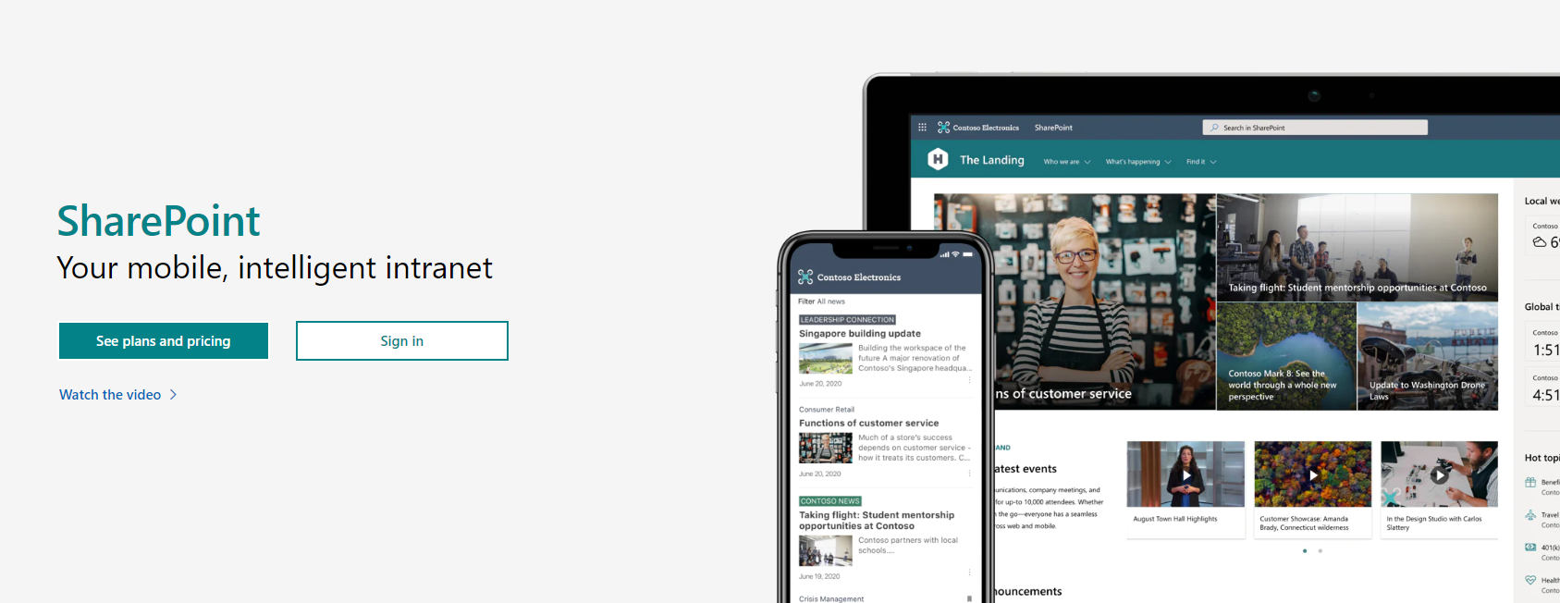
Sharepoint - Intro

Slide 7
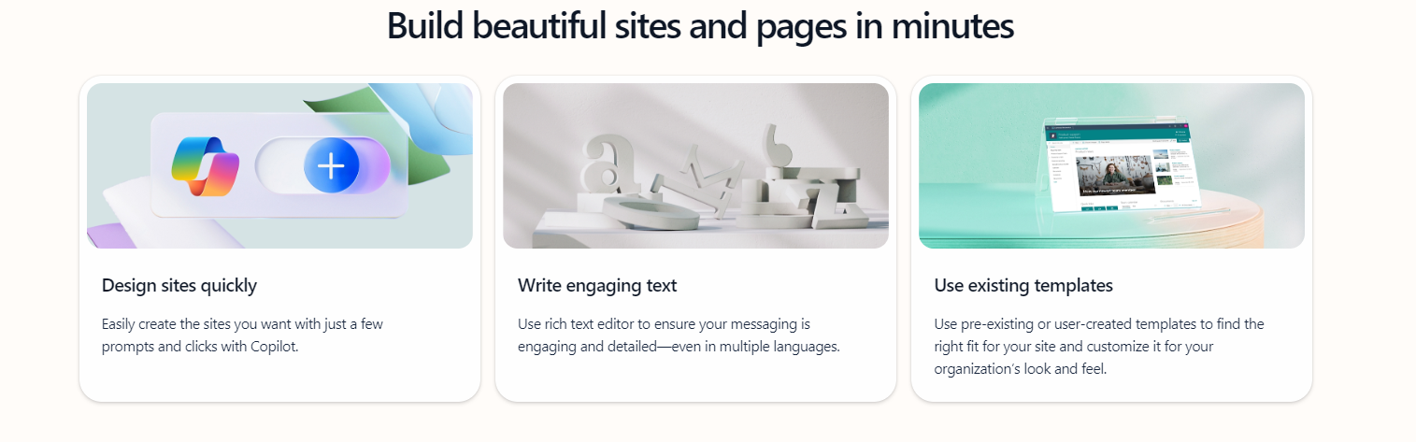
Sharepoint - Intro

Slide 8
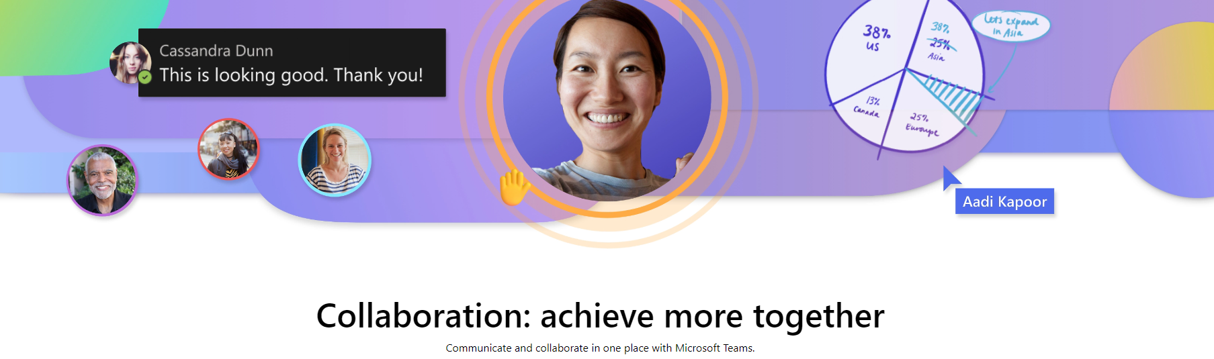
Sharepoint - Intro
Get the latest collaboration tools for business
Managing dispersed teams can be a challenge. Bring people together and empower them to get more done with Microsoft Teams.

Slide 9
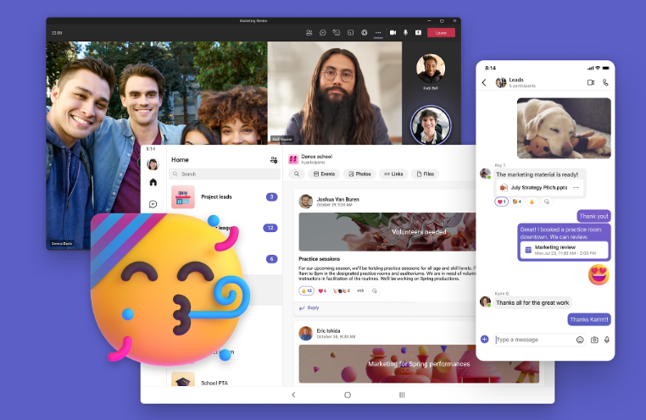
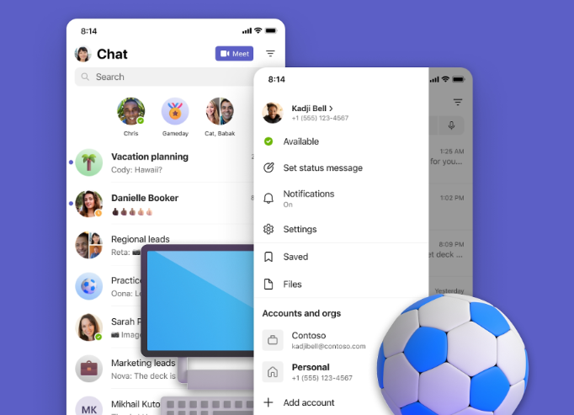
Sharepoint - Intro
Organize your life
Keep everything you need in one place: chats, meetups, files, and tasks. See activities, events, grocery lists, and chores from a single dashboard.
Make plans together
Plan activities more easily with chats, tasks, and shared to-do lists. Make decisions faster with instant polls, and share meeting invites directly in a group chat.

Slide 10
Sharepoint Online Administration Toolbox

Slide 11
Sharepoint Administration Toolbox
Responsible for all of the aspects of the SharePoint Online Service
Maintenance and Configuration
User Adoption and change management
Governance
Security & External Sharing
SharePoint Online is the file storage solution for othe Office 365 Services
Teams
Yammer
Usually also resposible of OneDrive for Business

Slide 12
Sharepoint Administration Toolbox
What tools Do You uses as a Sharepoint Online Administrator
The SharePoint Online Admin Center
PowerShell

Slide 13
Sharepoint Administration Toolbox
Requirements
Sharepoint admin role in M365
Service Administrator role in M365
See information on the service health and message center

Slide 14
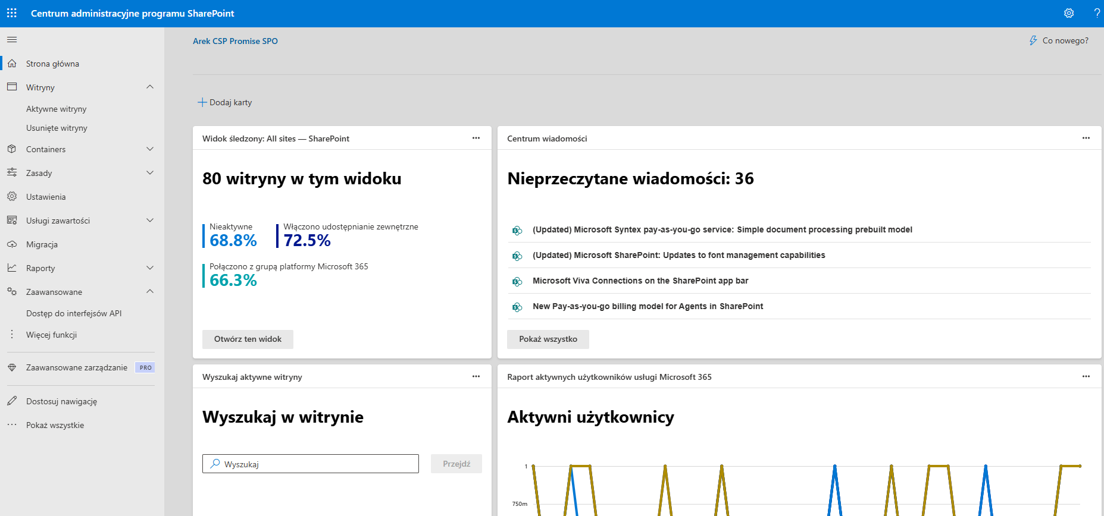
Sharepoint Administration Toolbox
ShrePoint Online Admin Center
https://<tenant>-admin.sharepoint.com

Slide 15

Sharepoint Administration Toolbox
Powershell
#check if you have already installed the SharePoint Online Management Shell by running the following command in administrative mode in PowerShell:
Get-Module -Name Microsoft.Online.SharePoint.PowerShell -ListAvailable | Select Name,Version
#Install Module
Install-Module -Name Microsoft.Online.SharePoint.PowerShell
#Update Module
Update-Module -Name Microsoft.Online.SharePoint.PowerShell
#Establish Connection
Connect-SPOService -Credential $creds -Url https://tenant-admin.sharepoint.com -ModernAuth $true -AuthenticationUrl https://login.microsoftonline.com/organizations
#To Connect with MFA
Connect-SPOService -Url https://contoso-admin.sharepoint.com

Slide 16
Sharepoint Administration Toolbox
Sharepoint PnP Powershell Module
The Microsoft 365 Platform Community (also known as M365 PnP community) is an open-source initiative coordinated by Microsoft 365 engineering. This community controls SharePoint development documentation, samples, reusable controls, and other relevant open-source initiatives related to SharePoint development.
What’s the supportability statement around PnP open-source components and solutions?
Following statements apply across all of the SharePoint PnP assets, including samples, controls, component and solutions, like SharePoint Starter Kit or the PnP Provisioning Service.
PnP assets are created by Microsoft & the community
PnP assets are maintained by Microsoft & the community
PnP uses supported and recommended techniques defined by Microsoft
PnP is NOT a product and therefore it’s not supported by Premier Support or other official support channels, but if the experienced issue(s) is caused by out-of-the-box API, it falls on the normal support patterns from Microsoft side
PnP is supported in similar ways as other open source projects done by Microsoft with support from the community by the community
There are numerous partners that utilize PnP within their solutions for customers. Support for this is provided by the Partner. When PnP material is used in deployments, we recommend being clear with your customer/deployment owner on the support model

Slide 17
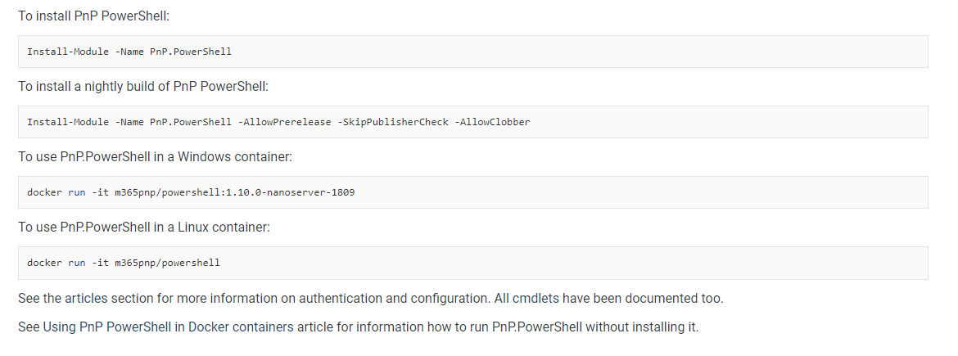
Sharepoint Administration Toolbox
Sharepoint PnP Powershell Module

Slide 18
LAB 01

Slide 19
Planning and Configuring Site Collections and Hub Sites

Slide 20
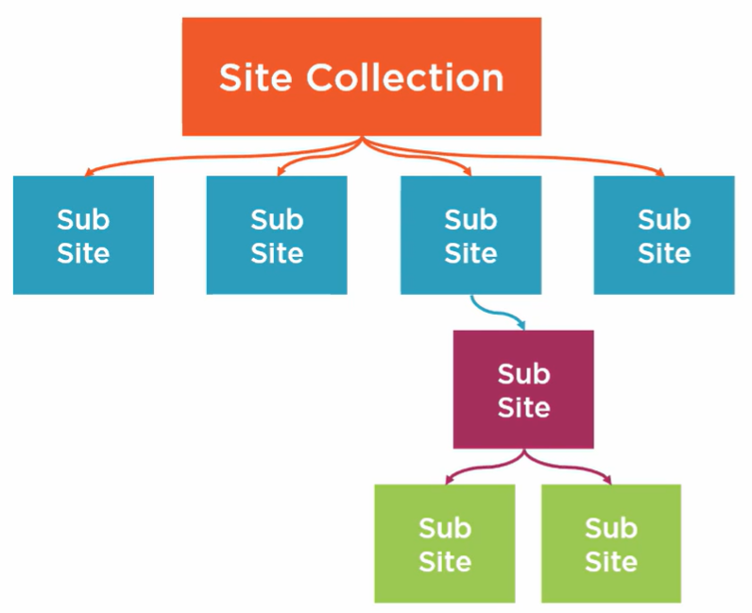
Planning and Configuring Site Collections and Hub Sites
Classic Sharepoint Information Architecture
What’s Inherited?
Permission
Navigation
Branding

Slide 21
Planning and Configuring Site Collections and Hub Sites
Classic Sharepoint Information Architecture
What’s Inherited?
Permission
Navigation
Branding

Slide 22
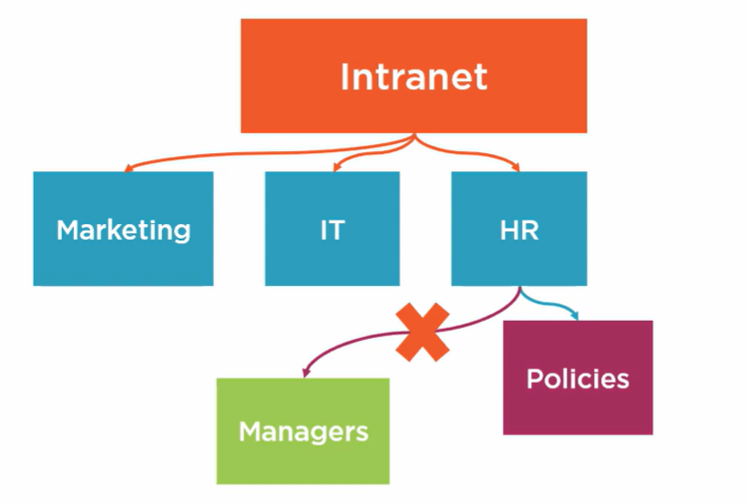
Planning and Configuring Site Collections and Hub Sites
Classic Sharepoint Intranet

Slide 23
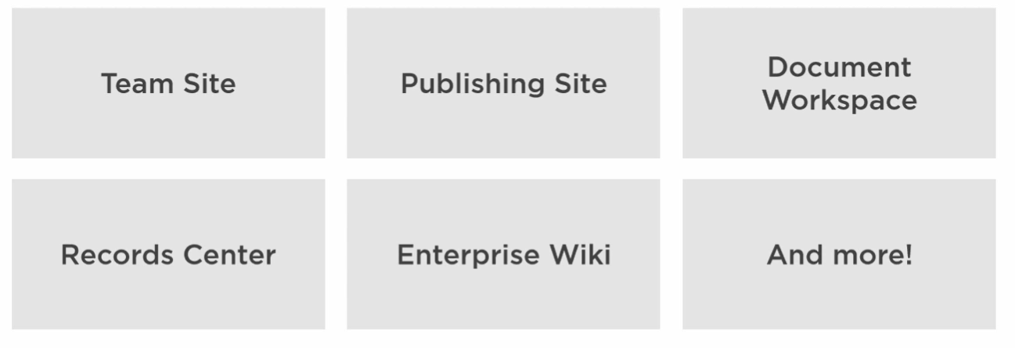
Planning and Configuring Site Collections and Hub Sites
Classic Sharepoint Templates

Slide 24
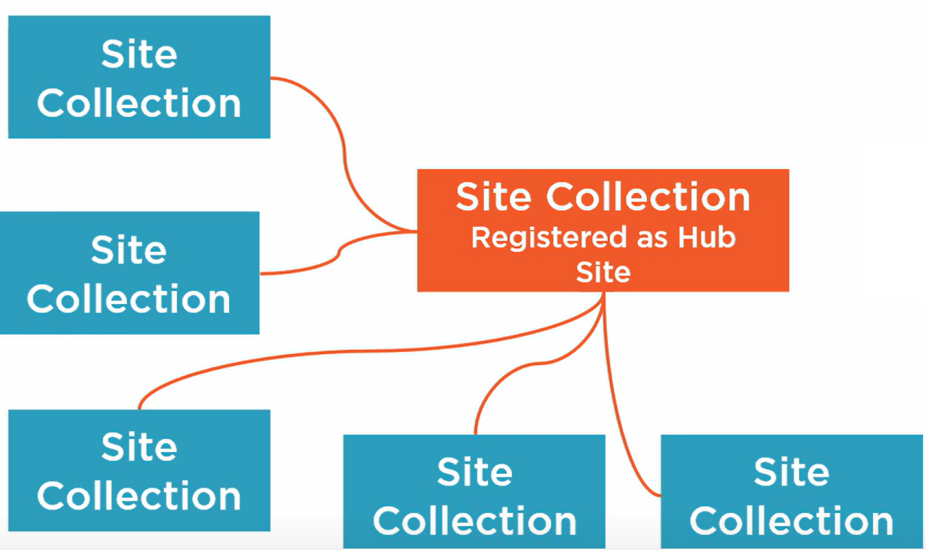
Planning and Configuring Site Collections and Hub Sites
Modern Sharepoint Information Architecture
What’s Inherited?
Navigation
Branding

Slide 25
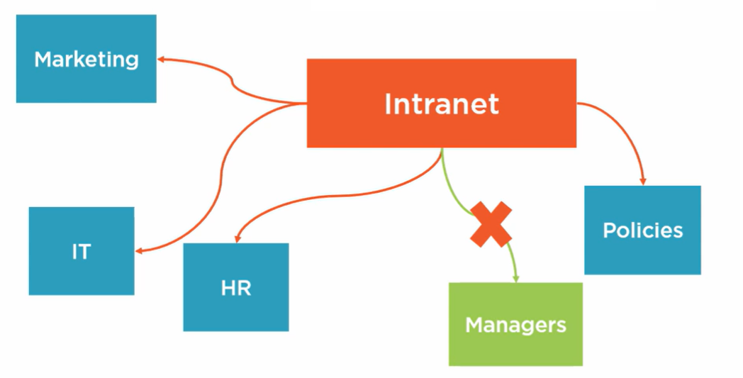
Planning and Configuring Site Collections and Hub Sites
Modern Sharepoint Intranet – Everything is a Site Collection

Slide 26
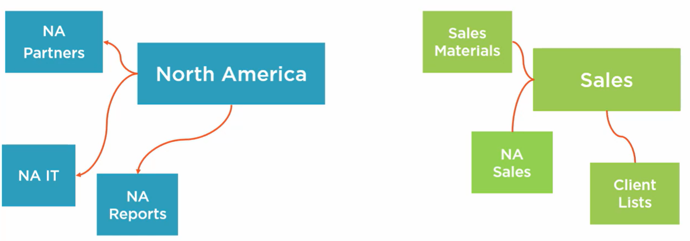
Planning and Configuring Site Collections and Hub Sites
Modern Sharepoint Intranet – Sites can be moved to other hubs

Slide 27
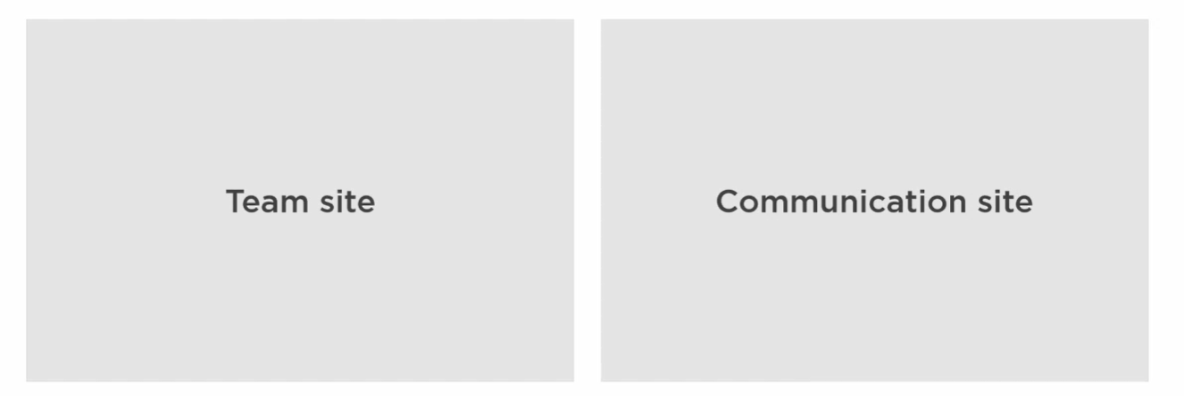
Planning and Configuring Site Collections and Hub Sites
Modern Sharepoint Templates

Slide 28
Planning and Configuring Site Collections and Hub Sites
Office 365 Groups
A collection of resources to make collaboration easier
Shared inbox (Shared mailbox)
SharePoint Site
Planner
(optional) Microsoft Teams
Creating a group Connected Teams Site will create all of the other resources
Team Sites without group can be groupified later on

Slide 29
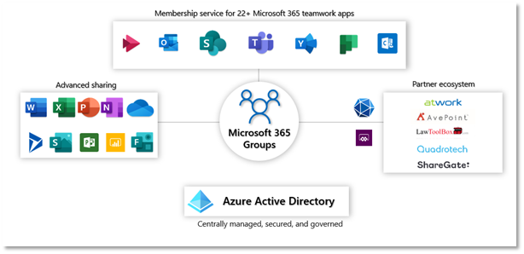
Planning and Configuring Site Collections and Hub Sites
Office 365 Groups

Slide 30
Groups and collaboration in Microsoft 365
Group
Teams
SharePoint
Planner
Stream
Yammer
Project
Calendar
OneNote
Power BI
Outlook
Every Teams team
Every SharePoint site
Every Outlook group
Every Stream group
Every Yammer community
Every Planner plan
…. is powered by a Microsoft 365 Group
Most groups have these resources*
*Not all groups have all resources (for example, Yammer communities don’t have a Teams team).
Notes:
Microsoft 365 Groups is more of a platform element that is integrated into the various productivity apps. For example every MS Teams team or SharePoint site is powered by a Microsoft 365 Group. Also, every Microsoft 365 Group comes with a number of resources(either automatically or optionally), so your users can get started quickly and reuse their existing groups across the suite. There are some exceptions to this rule through - by default we enable only one communication medium for each group and that is default to the one in which it is created.

Slide 31
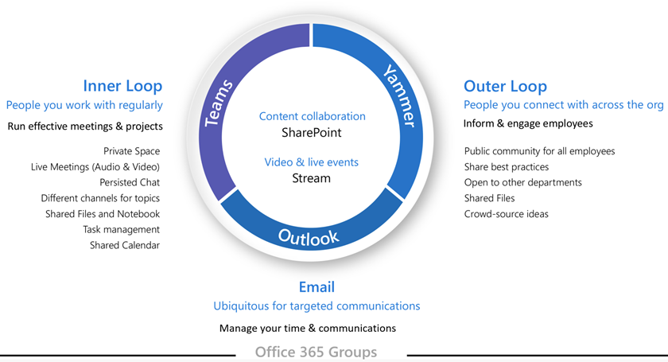
Planning and Configuring Site Collections and Hub Sites
Office 365 Groups
Groups can be created by creating any of the shared resources.
Creating a group in Outlook yields the same result as creating a group-connected SharePoint team site or a plan in Planner. If your users are new to Microsoft 365 Groups,
they may not realize this. This can lead to confusion for your users and the possibility of creating duplicate resources.
(For examples, someone might create a SharePoint site for document collaboration and later create a separate instance of Planner, not realizing Planner was already available as part of the group.)

Slide 32
Different types of Groups
Microsoft 365 Groups
Collaborate in shared workspaces
Security Groups
Grant access to resources and devices
Distribution Groups
Send emails to groups of people
Notes:
There are different types of groups available in Microsoft 365. This slide differentiates Microsoft 365 Groups from other kinds of groups. Security groups are managed by admins to provide the right access to resources and devices. Distribution groups act as email lists for sending out communication. Microsoft 365 Groups a new platform used in shared workspace scenarios with a focus on collaboration and productivity.

Slide 33
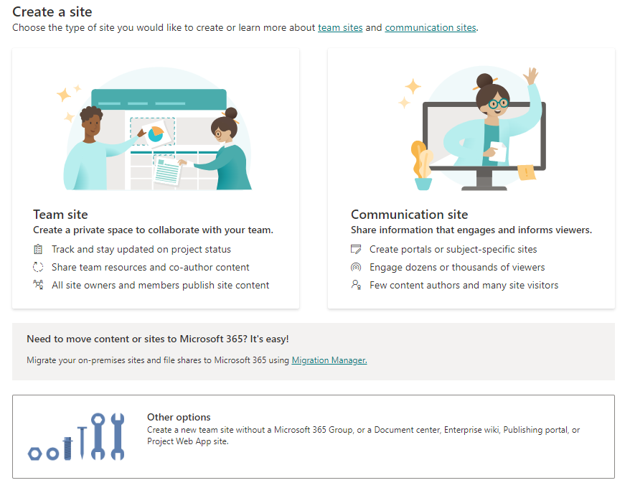
Planning and Configuring Site Collections and Hub Sites
Managing Site
Can either be done via Admin Center or Power Shell
Information needed
Title
Site Address
Langauage
Template
Primary Site Collection Admin
Time Zone
Storage Quota

Slide 34
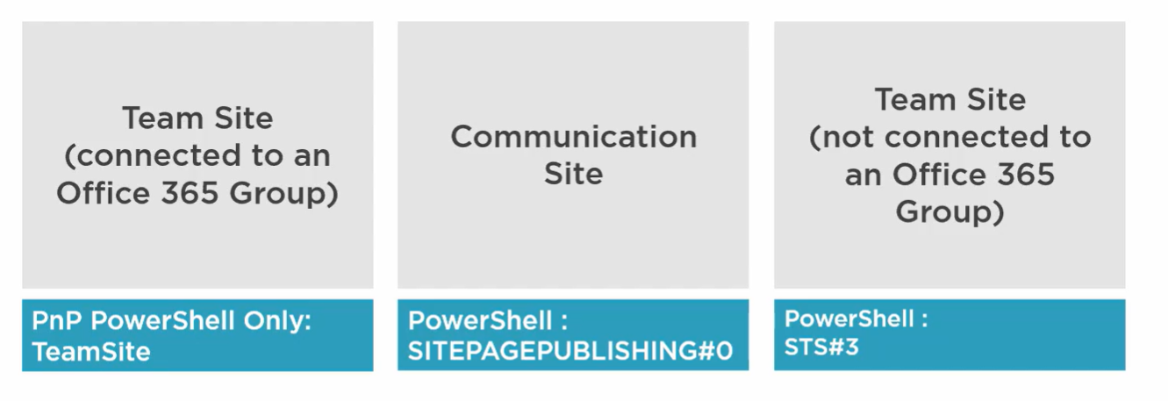
Planning and Configuring Site Collections and Hub Sites
Modern Site Template

Slide 35
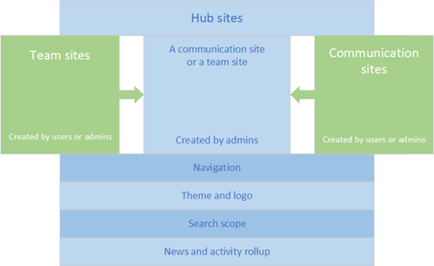
Planning and Configuring Site Collections and Hub Sites
Hub Sites
Modern SharePoint Site promoted to a Hub Site
Team Site
Communication Site
Global navigation added automatically
Configure who is allowed to add sites to the hub
- Can also configure an approval flow
Limit of 2000 Hub sites per tenant

Slide 36
Planning and Configuring Site Collections and Hub Sites
Hub Sites
To register site from admin Center
Register as Hub Site
Choose who can associate sites with the hub
Users
Security group
M365 group

Slide 37
Planning and Configuring Site Collections and Hub Sites
Permission
Site Administrators
Full control to everything inside the site
Can activate Site Collection features
Receive e-mail on various notifications
Site Owners
Manage Site Permission
Manage Site Artifacts
Site Members
Edit Permissions
Create Lists/Libraries
Create Content
Site Visitors
- Read Only Permission

Slide 38
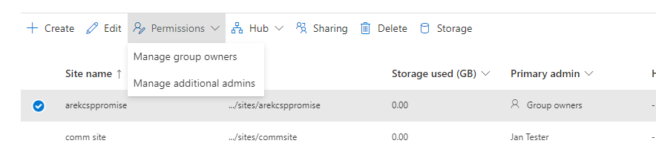
Planning and Configuring Site Collections and Hub Sites
Permission
Add Site admin via the Admin Center
Owners
Change Primary admin
Change admins

Slide 39
LAB 02

Slide 40
Configuring External Sharing

Slide 41
Configuring External Sharing
SharePoint Online allows you to share artifacts with users outside your organization
Complete Site
List or Library
Specific documents
Sharing is done differently depending on what you want to share

Slide 42
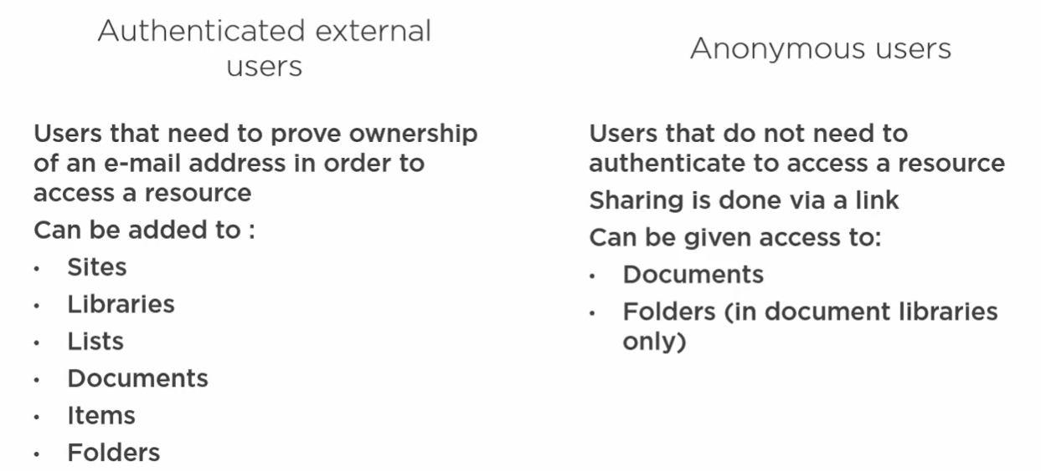
Configuring External Sharing
Types of External Users

Slide 43
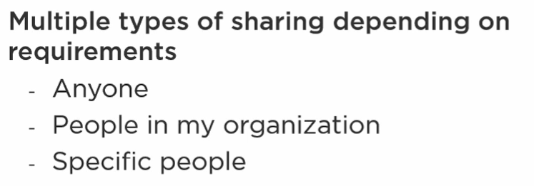
Configuring External Sharing
Types of Links

Slide 44
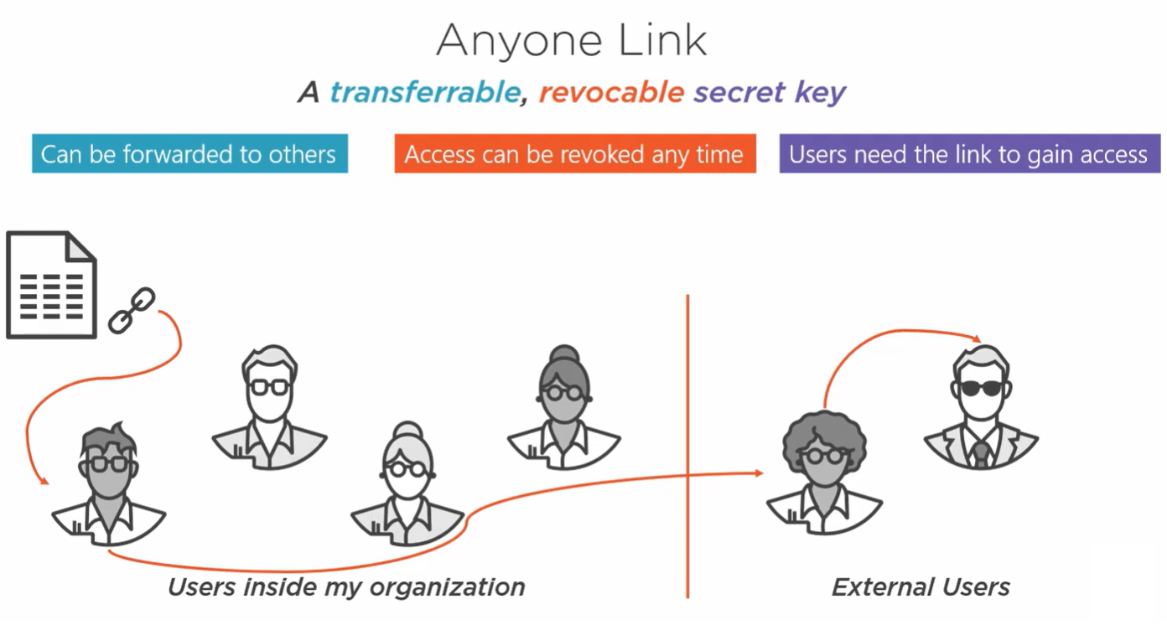
Configuring External Sharing

Slide 45
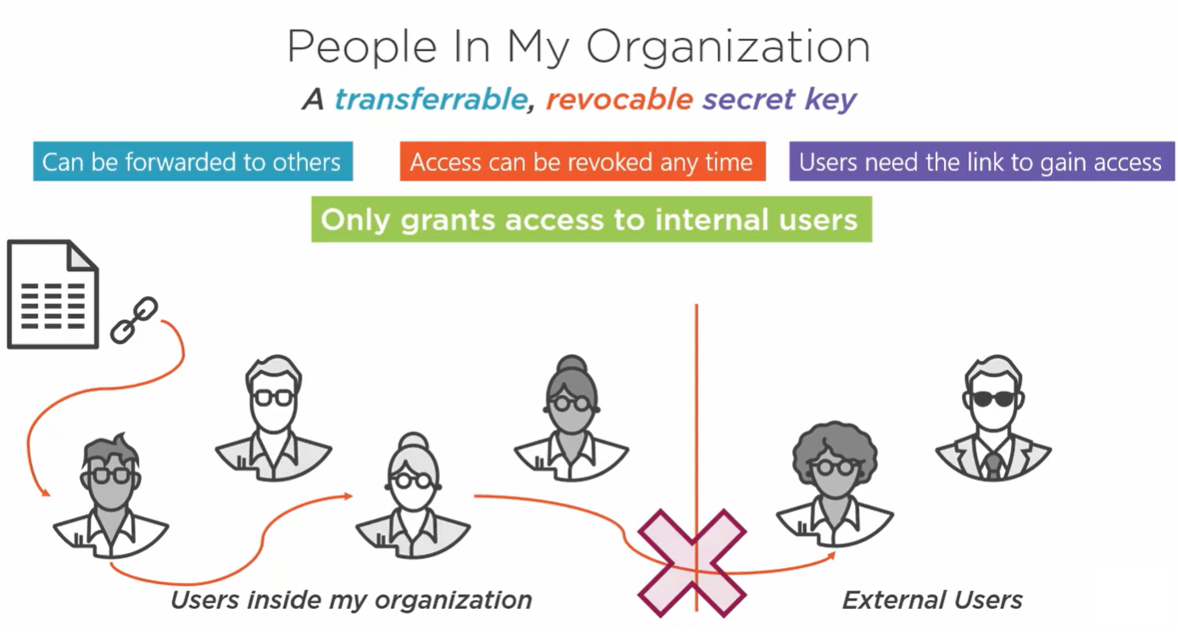
Configuring External Sharing

Slide 46
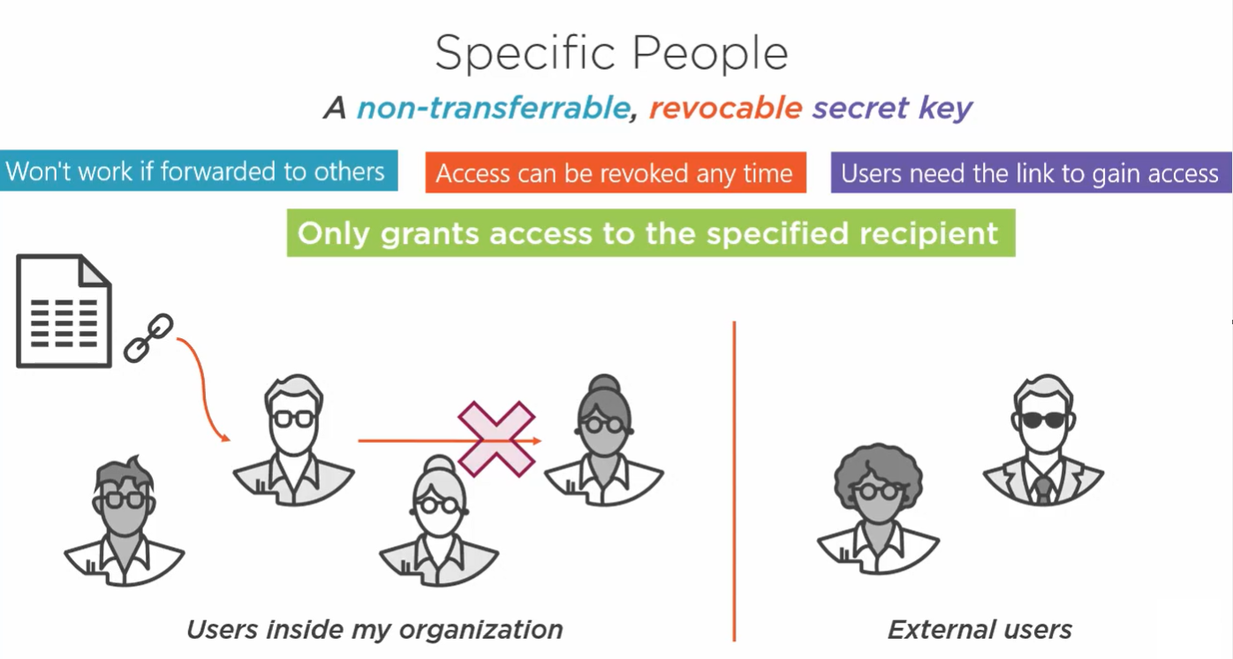
Configuring External Sharing

Slide 47
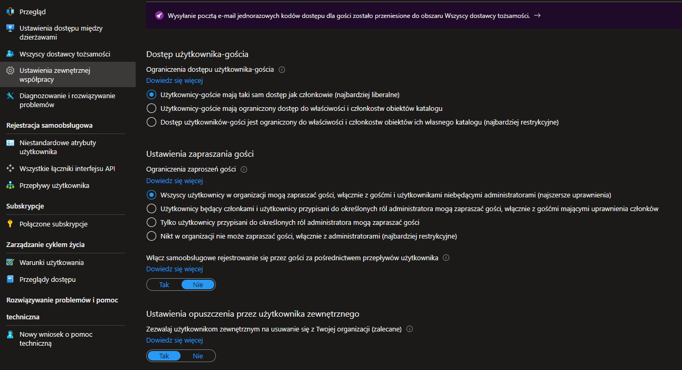
Configuring External Sharing
Where Can We Control Setting – tenant level

Slide 48
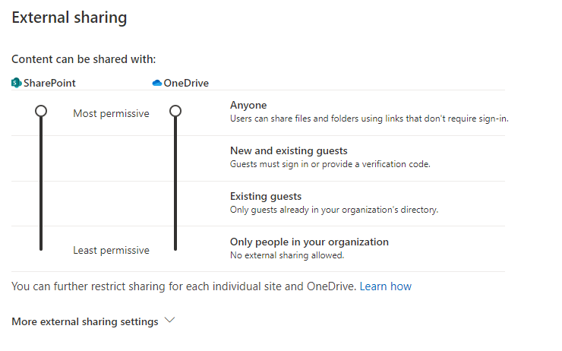
Configuring External Sharing
Where Can We Control Setting – Sharepoint Level

Slide 49
LAB 03

Slide 50
Planning and Configuring Metadata

Slide 51
Planning and Configuring Metadata
What is metadata
Metadata is information about information. For example, a book's title and author is metadata. Metadata can be many kinds of information -- a location, a date, or a catalog item number. When you use SharePoint products, you can manage the metadata centrally. You can organize the metadata in a way that makes sense in your business and use the metadata to make it easier to find what you want.

Slide 52
Planning and Configuring Metadata
Taxonomy
A taxonomy is a formal classification system. A taxonomy groups the words, labels, and terms that describe something, and then arranges the groups into a hierarchy.
People construct taxonomies for almost any kind of information, from biological systems to organizational structures. For example, biologists group living organisms into four major classifications: animal, plant, fungus, and microbe. Each of these major groups has many subdivisions. Together, the whole system is a taxonomy.
Organizations create taxonomies in too many ways to list. They create Chart of Accounts taxonomies to manage accounting systems, organization charts and job classifications to manage employees, product catalogs and so on. All these taxonomies are structured hierarchies of information; formal classification systems that help people handle information.

Slide 53
Planning and Configuring Metadata
Folksonomy
A folksonomy is an informal classification system. It evolves gradually as web site users collaborate on words, labels, and terms on a site. Originally, folksonomies developed from popular applications such as bookmarking.
If you have ever seen a tag cloud on a website, then you have seen a visualization of a folksonomy. The following figure shows a tag cloud on a SharePoint site.
A folksonomy-based approach to metadata can be useful. It creates a way to share the knowledge and expertise of site users. By using a folksonomy, content classification can evolve together with changing business needs and user interests.

Slide 54
Planning and Configuring Metadata
Term Set
A Term set is a group of related terms.
Terms sets can have different scope, depending on where you create the term set.
Local term sets are created within the context of a site collection, and are available for use (and visible) only to users of that site collection. For example, when you create a term set for a metadata column in a list or library, then the term set is local. It is available only in the site collection that contains this list or library. For example, a media library might have a metadata column that shows the kind of media (diagram, photograph, screenshot, video, etc.). The list of permitted terms is relevant only to this library, and available for use in the library.
Global term sets are available for use across all sites that subscribe to a specific Managed Metadata Service application. For example, an organization might create a term set that lists names of business units in the organization, such as Human Resources, Marketing, Information Technology, and so on.
In addition, you can configure a term set as closed or open. In a closed term set, users can't add new terms unless they have appropriate permissions. In an open term set, users can add new terms in a column that is mapped to the term set.

Slide 55
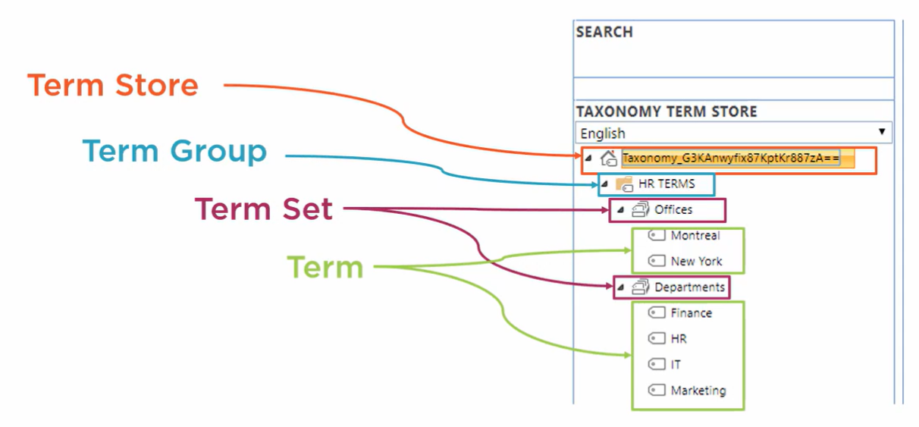
Planning and Configuring Metadata

Slide 56
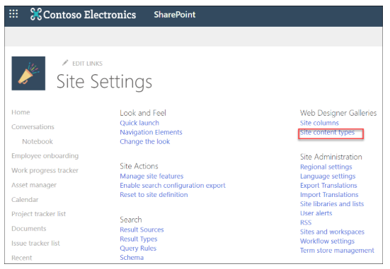
Planning and Configuring Metadata
Content Type
A content type in SharePoint is a reusable collection of templates,
metadata (columns),
workflows,
behavior,
and other settings for a category of items or documents.
A content type pulls together an item and information about the item.
The item might be one of many different kinds of files, a document, an excel workbook, or even a status indicator for a progress report.
It could also be a list or a folder. A content type associates this item with key metadata or other information such as a template or a retention policy.
It allows you to manage the settings for a category of information in a centralized, reusable way.

Slide 57
LAB 04

Slide 58
Managing Shrepoint Online Search

Slide 59
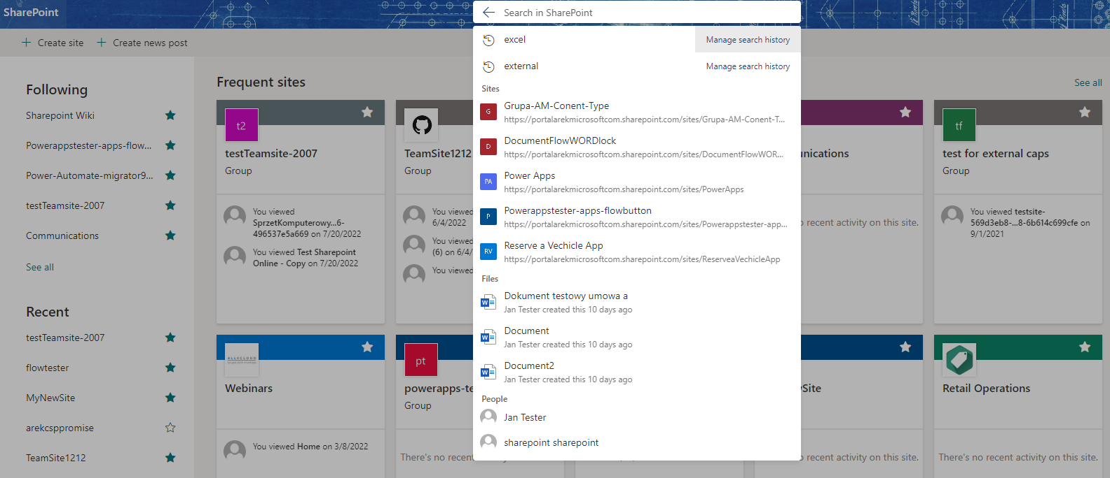
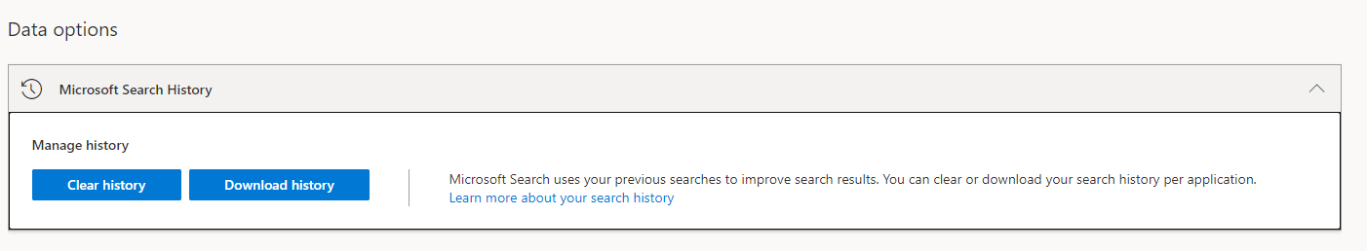
Managing Shrepoint Online Search
Search page in modern SharePoint sites
Zero Query recommendation
Cannot customize refiners or display templates

Slide 60
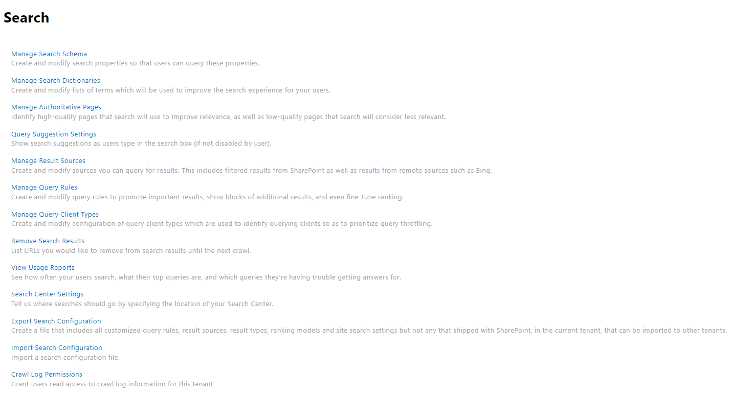
Managing Shrepoint Online Search

Slide 61
Managing Sharepoint User Profiles

Slide 62
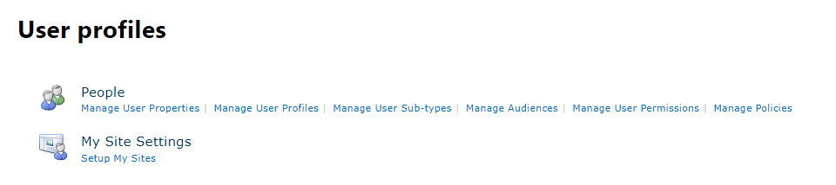
Managing Sharepoint User Profiles
In Microsoft 365, identity is managed by Azure Active Directory. SharePoint receives this profile information. If you need to store additional info about your users, you can create custom properties in the classic SharePoint admin center

Slide 63
Planning and Configuring Customization and Apps

Slide 64
Planning and Configuring Customization and Apps

Slide 65
Planning and Configuring Customization and Apps
In earlier versions of SharePoint, it was possible to make changes to a SharePoint environment by deploying custom code that would run in the physical SharePoint server environment. Changes made to SharePoint that didn't require the deployment of custom code were referred to as "customizations", because the changes were not fundamentally changing the product's functioning but were rather configuring the existing product in a unique way
Because of the shared nature of the SharePoint infrastructure, Microsoft does not allow the deployment of custom code to its environment. As a result, the concept of customizing SharePoint as opposed to deploying custom code is no longer a relevant paradigm.

Slide 66
Planning and Configuring Customization and Apps
Branding
Navigation
Page Content
Workflows
Forms
Customize your Sharepoint site programmatically
Use third-party apps and solutions

Slide 67
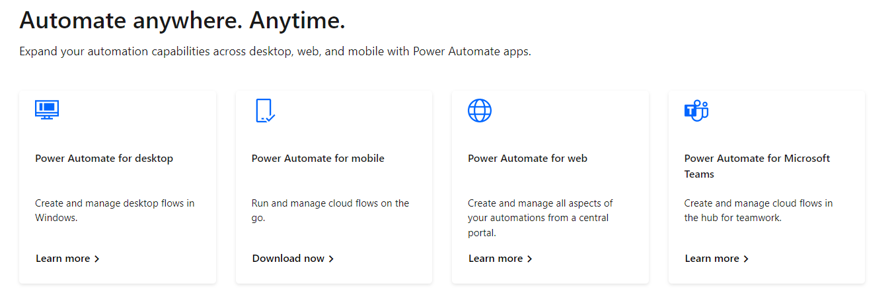
Planning and Configuring Customization and Apps
Workflow – Power Automate

Slide 68
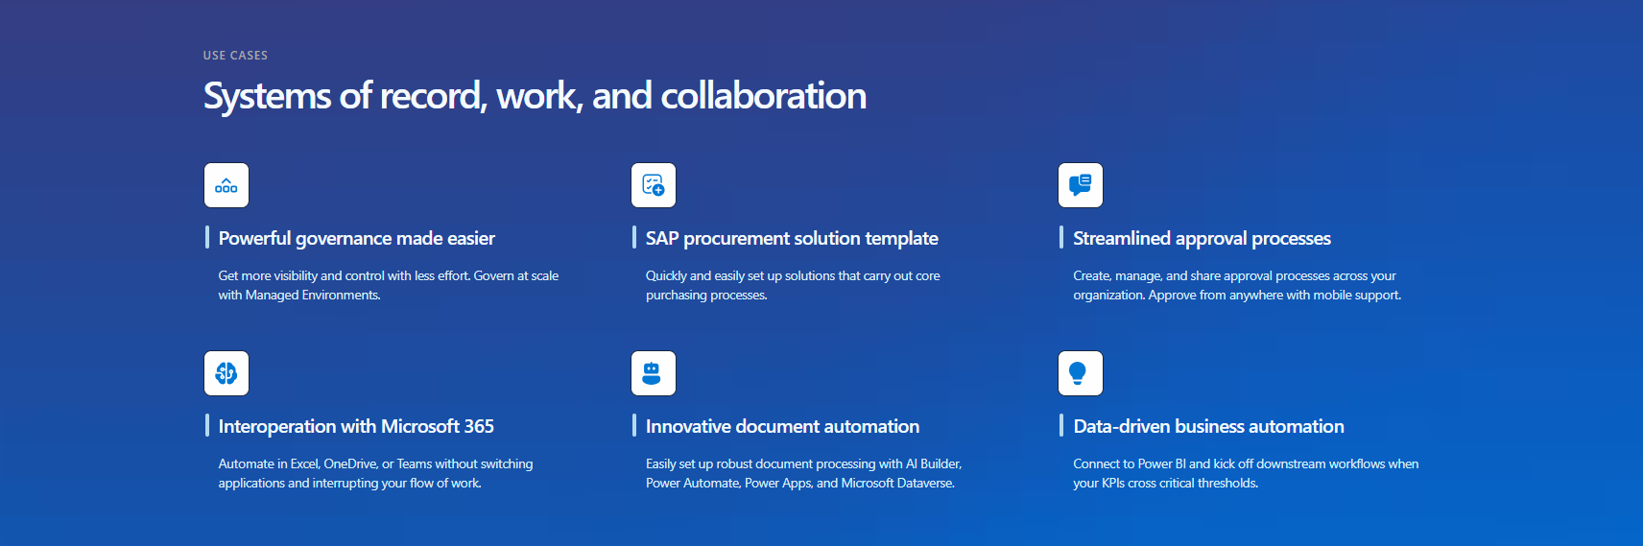
Planning and Configuring Customization and Apps
Workflow – Power Automate

Slide 69
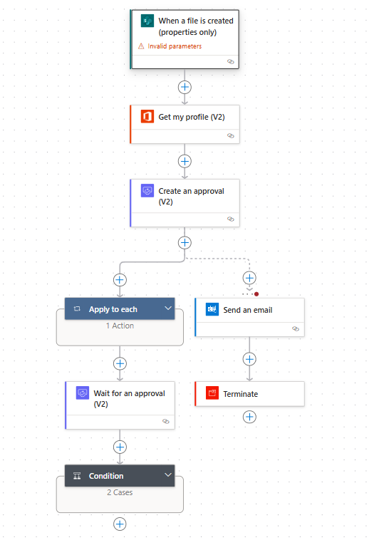
Planning and Configuring Customization and Apps
Workflow – Power Automate
Power Automate allows you to optimize your business processes across your organization and automate repetitive tasks.
This service helps you create automated workflows between your favorite apps and services to synchronize files, get notifications, collect data, and more

Slide 70
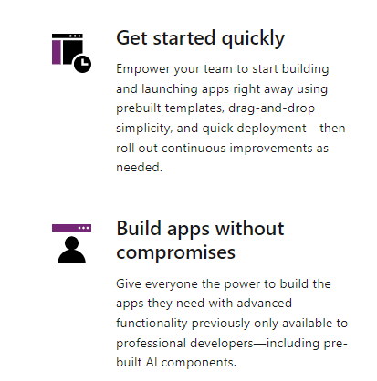
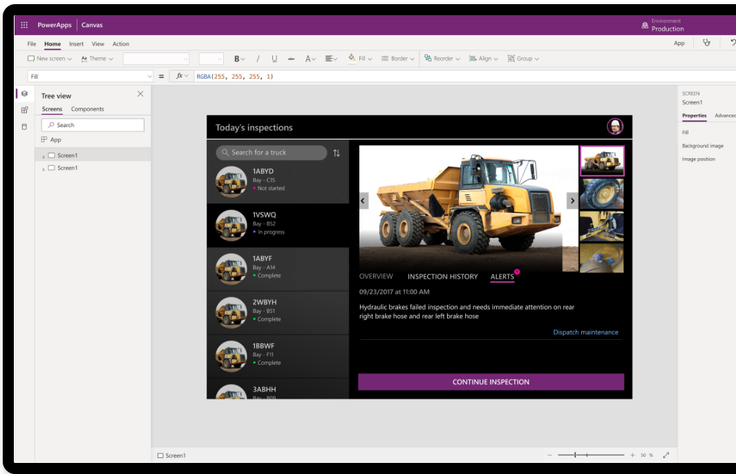
Planning and Configuring Customization and Apps
Power Apps

Slide 71
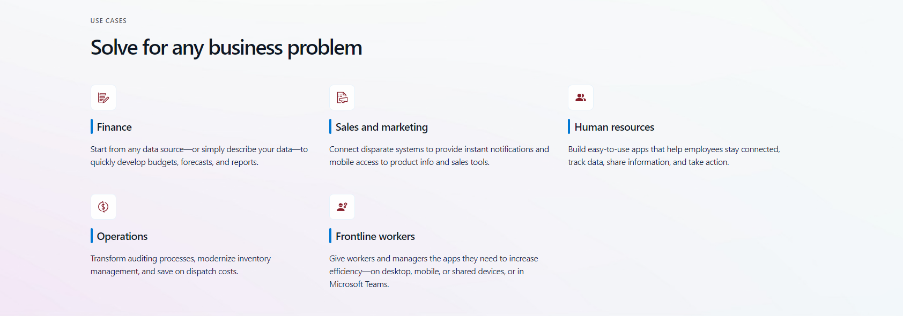
Planning and Configuring Customization and Apps
Power Apps

Slide 72
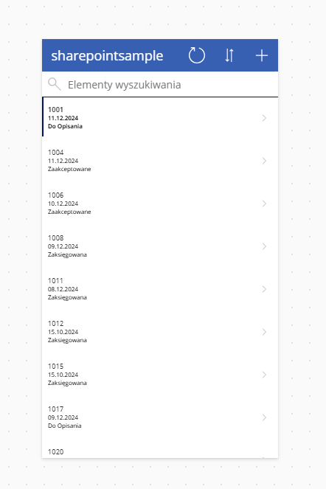
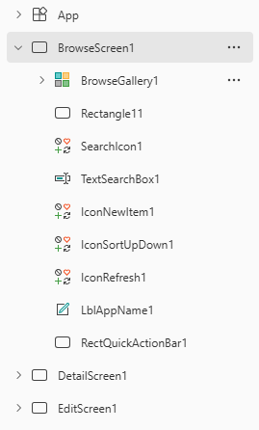
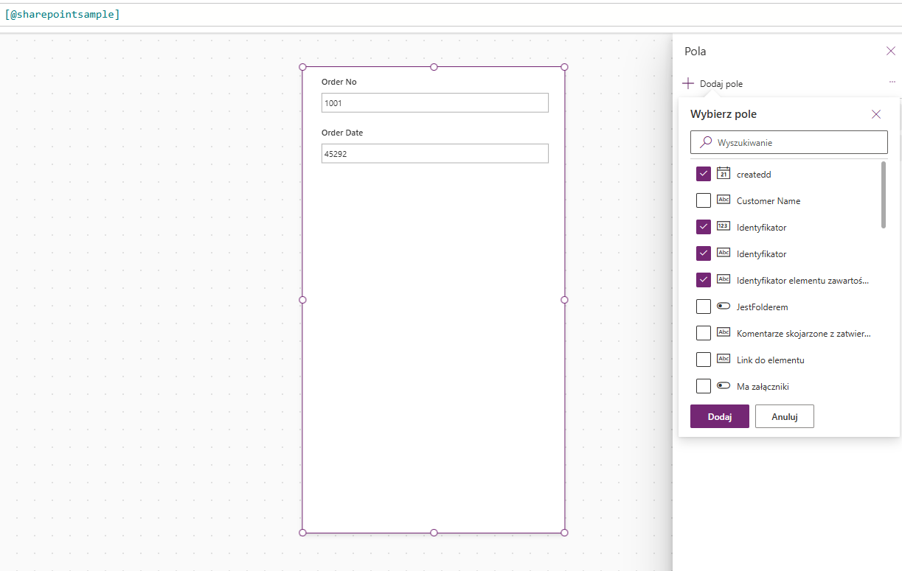
Planning and Configuring Customization and Apps
Power Apps – make your own app

Slide 73
LAB 05

Slide 74
Managing Other Tenant Setting

Slide 75
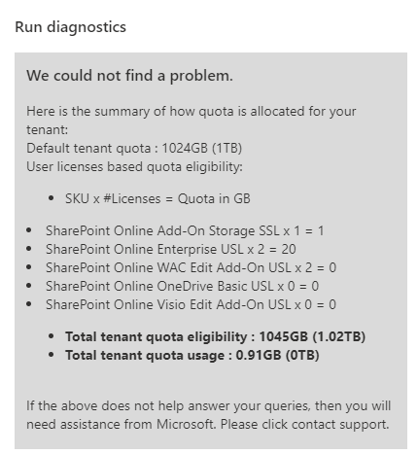
Managing Other Tenant Setting
The amount of Microsoft SharePoint storage for your organization is based on your number of licenses.
Your organization has total storage of 1 TB plus 10 GB per license of eligible plan purchased, plus any Microsoft 365 Extra File Storage add-on purchased.
If you suspect you should have more storage than is displayed in the Microsoft 365 admin center, Microsoft 365 admins can run the following diagnostic tool. It will identify any issues with your SharePoint Online tenant storage quota, and show how the quota is allocated.
https://aka.ms/PillarTenantStorage

Slide 76
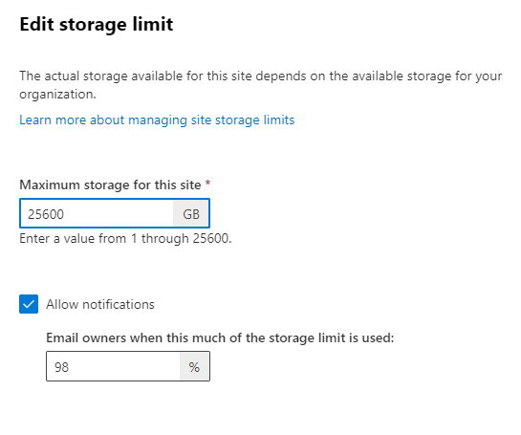
Managing Other Tenant Setting
Manage individual site storage limits
Follow these steps to specify individual site storage limits when your storage management option is set to "manual." We recommend that you also set an email alert so that you and other site admins can be notified when sites are nearing the storage limit. To learn how to set the default storage limit for new sites, see Manage site creation.
Go to Active sites in the SharePoint admin center, and sign in with an account that has admin permissions for your organization.
Click a site, or for a channel site, select the link in the Channel sites column.
Under Storage limit, select Edit.
Enter the maximum storage in GB for the site.
Make sure Notifications is turned on to send an email to site admins when the site approaches the storage limit. Then, enter a value as a percent for how full you want the storage to be when the email is sent.
Select Save.

Slide 77
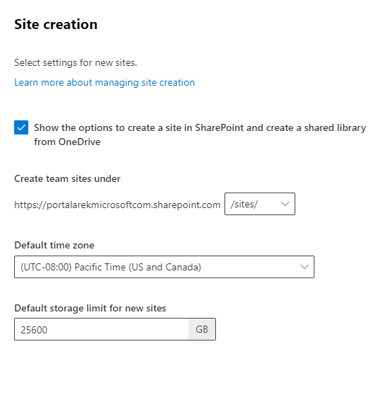
Managing Other Tenant Setting
As a Global Administrator or SharePoint Administrator in Microsoft 365, you can let your users create and administer their own SharePoint sites, determine what kind of sites they can create, and specify the location of the sites. By default, users can create communication sites and Microsoft 365 group-connected team sites.

Slide 78
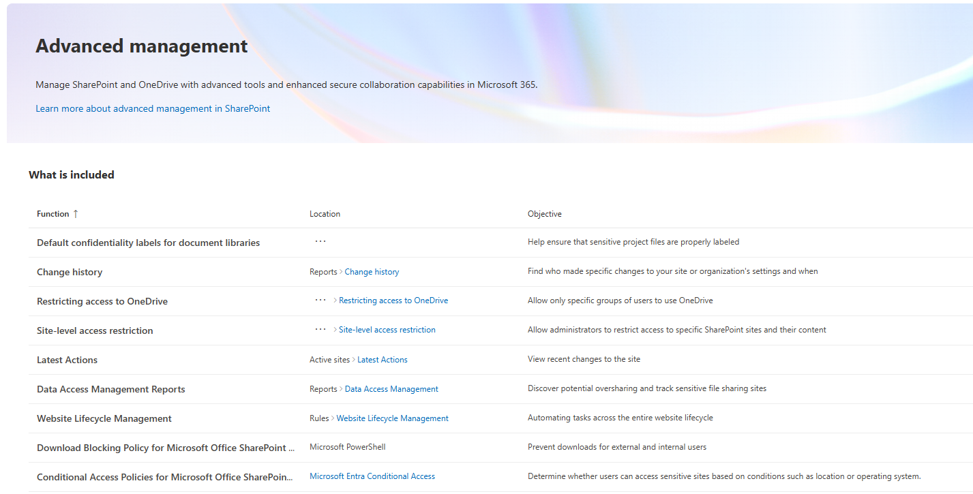
Managing Other Tenant Setting – Advanced Management

Slide 79
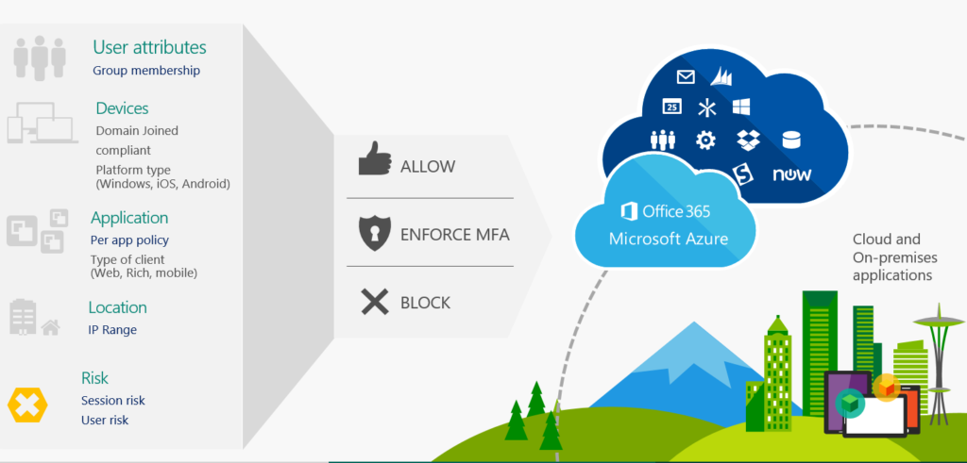
Managing Other Tenant Setting

Slide 80
LAB 06

Slide 81
Managing Content

Slide 82
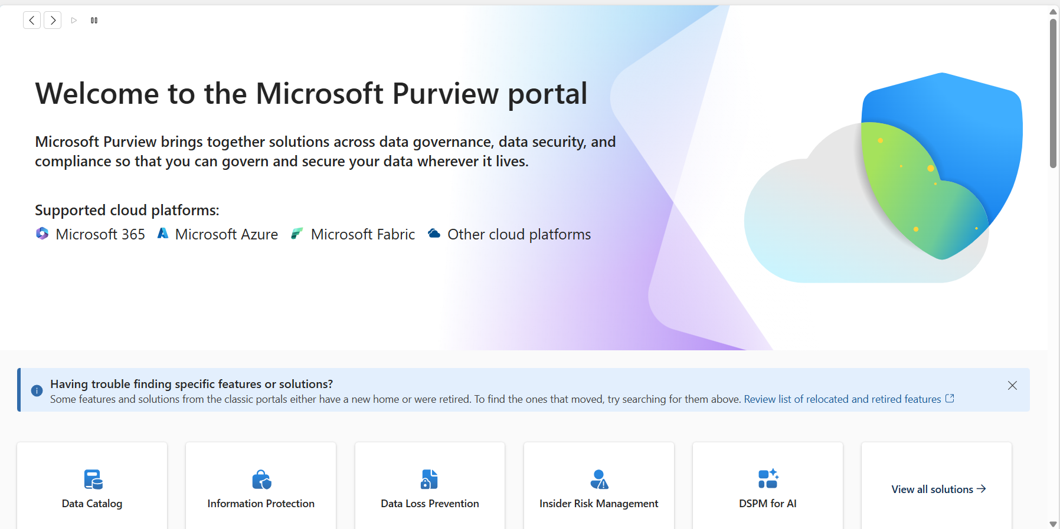

Slide 83
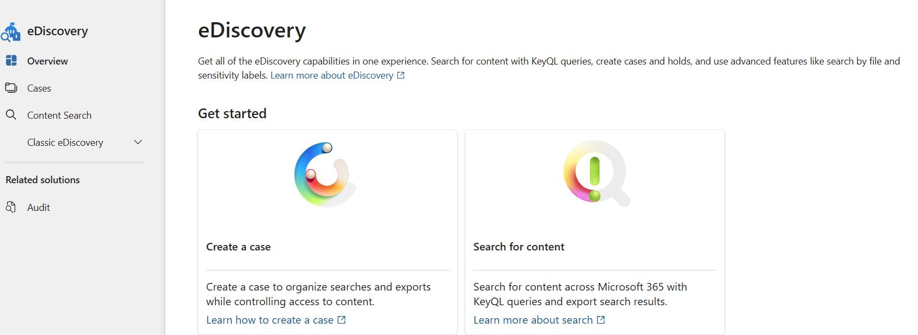
Mechanizm eDsicovery
eDiscovery w SharePoint umożliwia wyszukiwanie, zabezpieczanie i eksportowanie danych na potrzeby postępowań prawnych. Użytkownicy mogą tworzyć sprawy eDiscovery, stosować blokady (hold) i przeszukiwać zawartość w SharePoint i Exchange.

Slide 84
Mechanizm eDsicovery
eDiscovery w SharePoint umożliwia wyszukiwanie, zabezpieczanie i eksportowanie danych na potrzeby postępowań prawnych. Użytkownicy mogą tworzyć sprawy eDiscovery, stosować blokady (hold) i przeszukiwać zawartość w SharePoint i Exchange.

Slide 85




Data Loss Prevention in Microsoft Office
Identify
Monitor
Helps to
identify
monitor
protect
sensitive data through deep content analysis
Protect
End user education

Slide 86
Built-in DLP Content Areas
Country/Region | PII | Financial | Health
US | US State Security Breach Laws, US State Social Security Laws, COPPA | GLBA & PCI-DSS (Credit, Debit Card, Checking and Savings, ABA, Swift Code) | Limited Investment: US HIPPA, UK Health Service, Canada Health Insurance card Rely on Partners and ISVs
Germany | EU data protection, Drivers License, Passport National Id | EU Credit, Debit Card, IBAN, VAT, BIC, Swift Code
UK | Data Protection Act, UK National Insurance, Tax Id, UK Driver License, Passport | EU Credit, Debit Card, IBAN, BIC, VAT, Swift Code
Canada | PIPED Act, Social Insurance, Drivers License | Credit Card, Swift Code
France | EU data protection, Data Protection Act, National Id (INSEE), Drivers License, Passport | EU Credit, Debit Card, IBAN, BIC, VAT, Swift Code
Japan | PIPA, Resident Registration, Social Insurance, Passport, Driving License | Credit Card, Bank Account, Swift Code
Australia | Drivers License, Passport, Social Insurance | Credit Card, Bank Account, Swift Code
Finland | Finland National ID
Poland | Poland National ID (PESEL), Poland Identity Card, Poland Passport

Slide 87
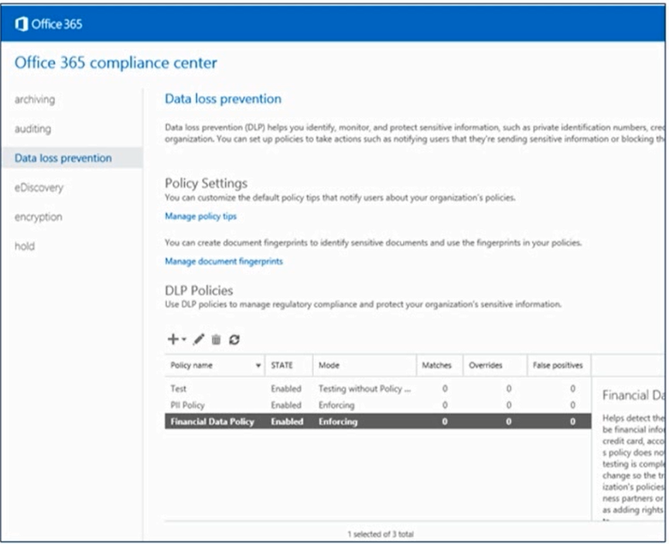
Data Loss Prevention in Compliance Center
Managing DLP policies across Office 365 workloads
One policy definition independent of workload
One policy lifecycle
One set of sensitive type definitions
New DLP policy from Template
Import DLP policy

Slide 88

Managing DLP policies across Office 365 workloads
One policy definition independent of workload
One policy lifecycle
One set of sensitive type definitions
New DLP policy from Template
Import DLP policy

Slide 89

Managing DLP policies across Office 365 workloads
One policy definition independent of workload
One policy lifecycle
One set of sensitive type definitions
New DLP policy from Template
Import DLP policy

Slide 90
LAB 07

Slide 91
Sharepoint Premium oraz Syntex

Slide 92

Managing Other Tenant Setting – Advanced management
SharePoint Advanced Management is an essential add-on for Microsoft 365 that equips IT administrators with a powerful suite of tools to bolster content governance throughout the Microsoft Copilot deployment journey.
Whether preparing for Copilot deployment or managing content post-implementation, this solution offers capabilities to:
prevent content sprawl,
streamline access management for SharePoint and OneDrive sites, and
analyze usage patterns through comprehensive reporting.

Slide 93

Managing Other Tenant Setting – Advanced management

Slide 94
Sharepoint Advanced Management - DEMO

Slide 95

Managing Other Tenant Setting – Sharepoint Syntex
Microsoft Syntex is a powerful suite of AI-powered content management and productivity services designed to help your organization transform how you handle documents and information.
A flexible pay-as-you-go model gives you access to advanced capabilities—such as intelligent document discovery, classification, analysis, and processing—without the need for upfront licensing commitments.
By automating content workflows and enhancing document understanding, your everyday business content is turned into actionable knowledge. This not only streamlines operations and reduces manual effort, but also empowers people in your organization to make faster, more informed decisions based on insights extracted from their content.
Microsoft Syntex

Slide 96

Managing Other Tenant Setting – Sharepoint Syntex

Slide 97

Managing Other Tenant Setting – Sharepoint Syntex

Slide 98


Managing Other Tenant Setting – Sharepoint Syntex
Microsoft Syntex services are billed on a pay-as-you-go basis. These services use an Azure subscription for billing and track usage and cost with a Syntex meter.
Read the Microsoft Syntex pay-as-you-go terms of service before you configure pay-as-you-go.

Slide 99
Other Applications

Slide 100


Other Application – Microsoft Teams and Sharepoint
Every Teams channel has a SharePoint team site, and every SharePoint team site has a Teams channel. SharePoint is great for storing files in the cloud and making them accessible to a broad audience.
And, you can take advantage of robust file permission management, document process flows, retention policies, and more. Here are ways to work with SharePoint:

Slide 101


Other Application – Microsoft Viva
Microsoft Viva is the employee experience platform within Microsoft 365 and Teams..

Slide 102
Other Application – Microsoft Viva
Microsoft Viva is the employee experience platform within Microsoft 365 and Teams. Here you can find documentation, solutions, training, and resources for using Microsoft Viva.
Experience | App | App
Employee communications and communities | Viva Amplify Centralize campaign management, publishing, and reporting to reach and engage employees. Viva Engage Bring people together across the organization to connect with leaders, coworkers, and communities. | Viva Connections Connect employees with tools, news, and resources through this customizable app in Microsoft Teams. :
Workplace Analytics and Feedback | Viva Insights Improve employee productivity and well-being through data-driven insights and recommendations. Viva Pulse Empower leaders and managers to seek and act on feedback when it matters. | Viva Glint A "voice of the employee" solution helping organizations understand and improve employee engagement to drive business outcomes.

Slide 103
Other Application – Microsoft Viva
Microsoft Viva is the employee experience platform within Microsoft 365 and Teams. Here you can find documentation, solutions, training, and resources for using Microsoft Viva.
Learning and knowledge management | Viva Learning Bring enterprise learning into the flow of work by connecting content from your organization with other sources
Goal setting and management | Viva Goals Align teams and employees with your organization’s strategic goals and priorities.

Slide 104



Other Application – Microsoft Loop
Kick off projects and work together with intelligent suggestions, page templates, and an insert menu that provides instant access to components.

Slide 105

Other Application – Microsoft Loop
Loop content is stored in SharePoint, OneDrive, and SharePoint Embedded,
allowing familiar management within existing file management workflows.
Where the content was originally created determines its storage location:

Slide 106
Monitoring and Maintaning Sharepoint Online Services

Slide 107

Monitoring and Maintaning Sharepoint Online Services
Service Health dashboard
Single location to view the status M365 services
Located in M365 admin center
Helthy
Advisory
Incident

Slide 108

Monitoring and Maintaning Sharepoint Online Services

Slide 109

Monitoring and Maintaning Sharepoint Online Services
Get the latest updates on our best-in-class productivity apps and intelligent cloud services. Rethink productivity, streamline business processes, and protect your business with Microsoft 365.
https://www.microsoft.com/en-us/microsoft-365/roadmap

Slide 110
Dziękuję za uwagę ☺

